Slide 1

Data Mining
Handwritten digital picture data processing and recognition
Mohamed Ibrahim
22 / 11 / 2024

Slide 2
Introduction
Data mining is the process of discovering patterns, correlations, anomalies, and useful information from large datasets using statistical and computational techniques.
01
What is Data Mining?
It is a part of the larger process called Knowledge Discovery Databases (KDD), which involves selecting, preprocessing, transforming, and interpreting data.
02
03
The primary goal of data mining is to extract patterns from data that can be used for decision-making, predictions, and discovering trends.

Slide 3
Why TensorFlow?*
Extensive Ecosystem
Efficient Model Training
Support for Hardware Acceleration
Cross-Platform Deployment
TensorFlow provides a comprehensive ecosystem for deep learning, including tools like TensorBoard for visualization and TensorFlow Lite for deploying models on mobile and embedded devices. This makes it highly versatile for both research and production.
TensorFlow’s graph-based execution allows for optimized computation and better performance when training large and complex models, compared to PyTorch's eager execution mode
TensorFlow efficiently utilizes GPUs and TPUs to speed up model training, which is crucial for deep learning tasks with large datasets like digit recognition.
TensorFlow excels in deploying models across various platforms, including servers, web, and mobile. This future-proofs the project in case deployment is required.

Slide 4
Overview of the Project
Project Objective:
Tools and Technologies
The aim of this project is to classify images as either from 0 to 9 using machine learning techniques.
Data Mining: The project applies data mining techniques to extract features from images and categorize them.
Image Dataset: A set of images containing number from 0 to 9 is used for training and testing.
TensorFlow/Keras: Deep learning framework used to implement the MobileNetV2 model
Programming language : Python
This model will be able to accurately classify new images as imgage from 0 to 9, achieving a high level of accuracy in predictions.

Slide 5
Importance of Image Classification
Image classification is a fundamental problem in computer vision, used in various real-world applications like medical imaging, facial recognition, and object detection.
Accurate classification helps automate decision-making processes, improve efficiency, and reduce human error.
we have 2 way
Manual Image Sorting: Manually identifying and sorting images into categories (cats and dogs) is time-consuming and prone to mistakes.
Automation Sorting : There is a need for an automated solution that can quickly and accurately classify large volumes of images.

Slide 6
Significance of Handwritten Digit Recognition
1. Postal Services :
Sorting handwritten mail based on zip codes or addresses, automating the mail sorting process.
2. Banking:
Automating the processing of handwritten checks, reducing human error and improving the speed of transactions.
3. Document Digitization:
Converting handwritten forms, surveys, and other documents into machine-readable formats, enabling efficient data storage and analysis.
4. License Plate Recognition:
Recognizing handwritten vehicle registration numbers in traffic management systems.
5. Medical Transcription:
Converting handwritten medical records into digital form for improved patient record management.

Slide 7
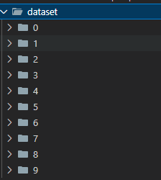
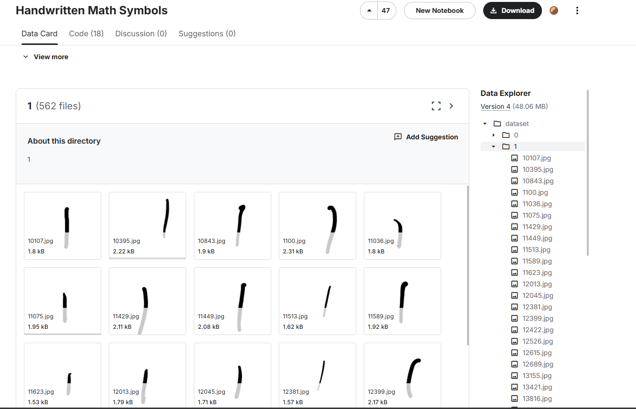
Data Preparation
make a folder name data set and add some img in it
follow this link to get dateser
https://www.kaggle.com/datasets/sagyamthapa/handwritten-math-symbols?select=dataset

Slide 8
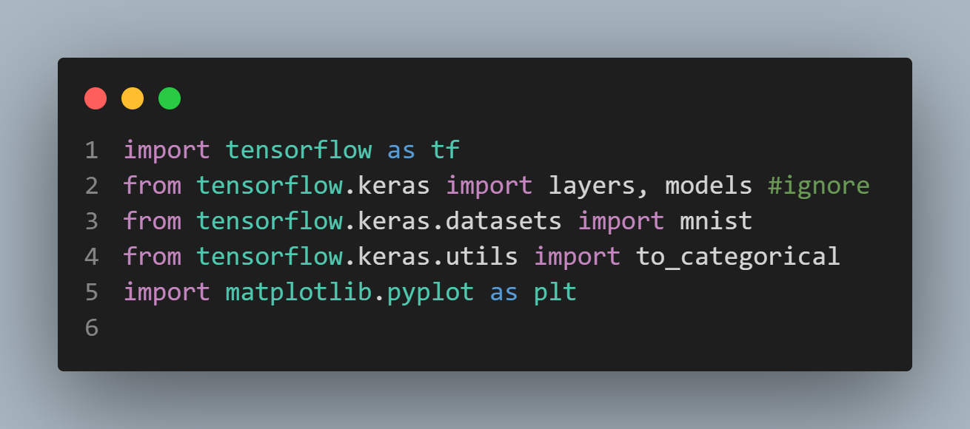
make Virtual environment )venv )
Follow this llink to setup
https://docs.python.org/3/library/venv.html
Follow this llink to setup
https://www.activestate.com/resources/quick-reads/how-to-install-keras-and-tensorflow/
Then

Slide 9
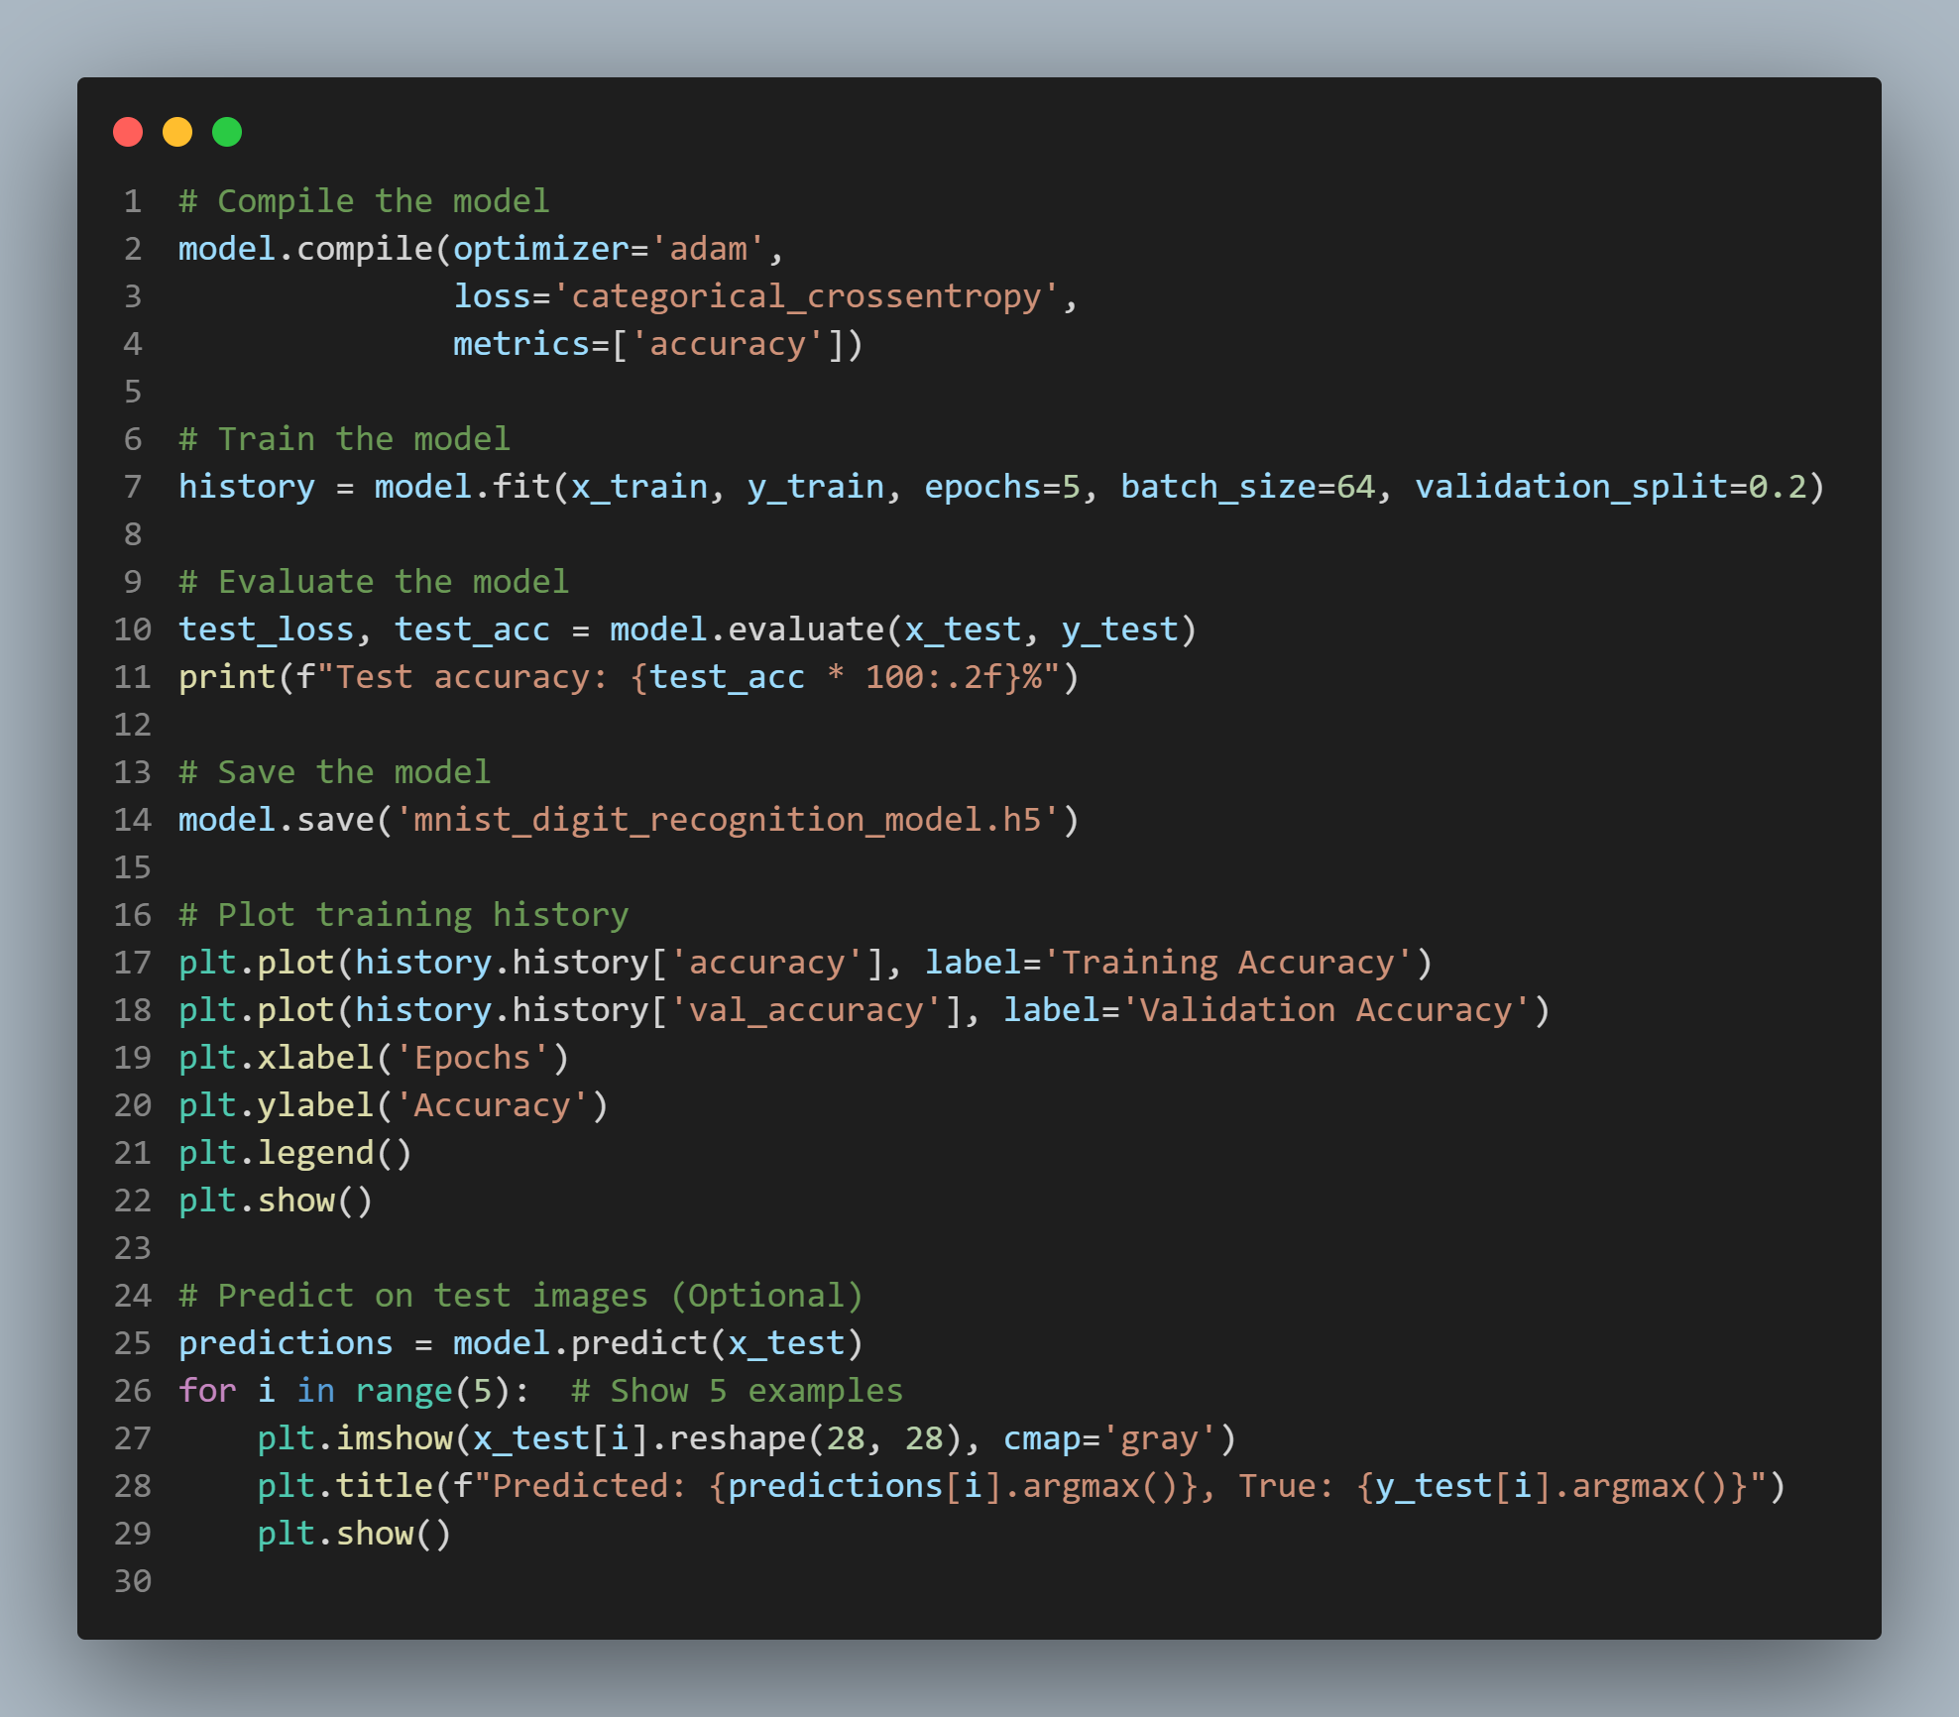
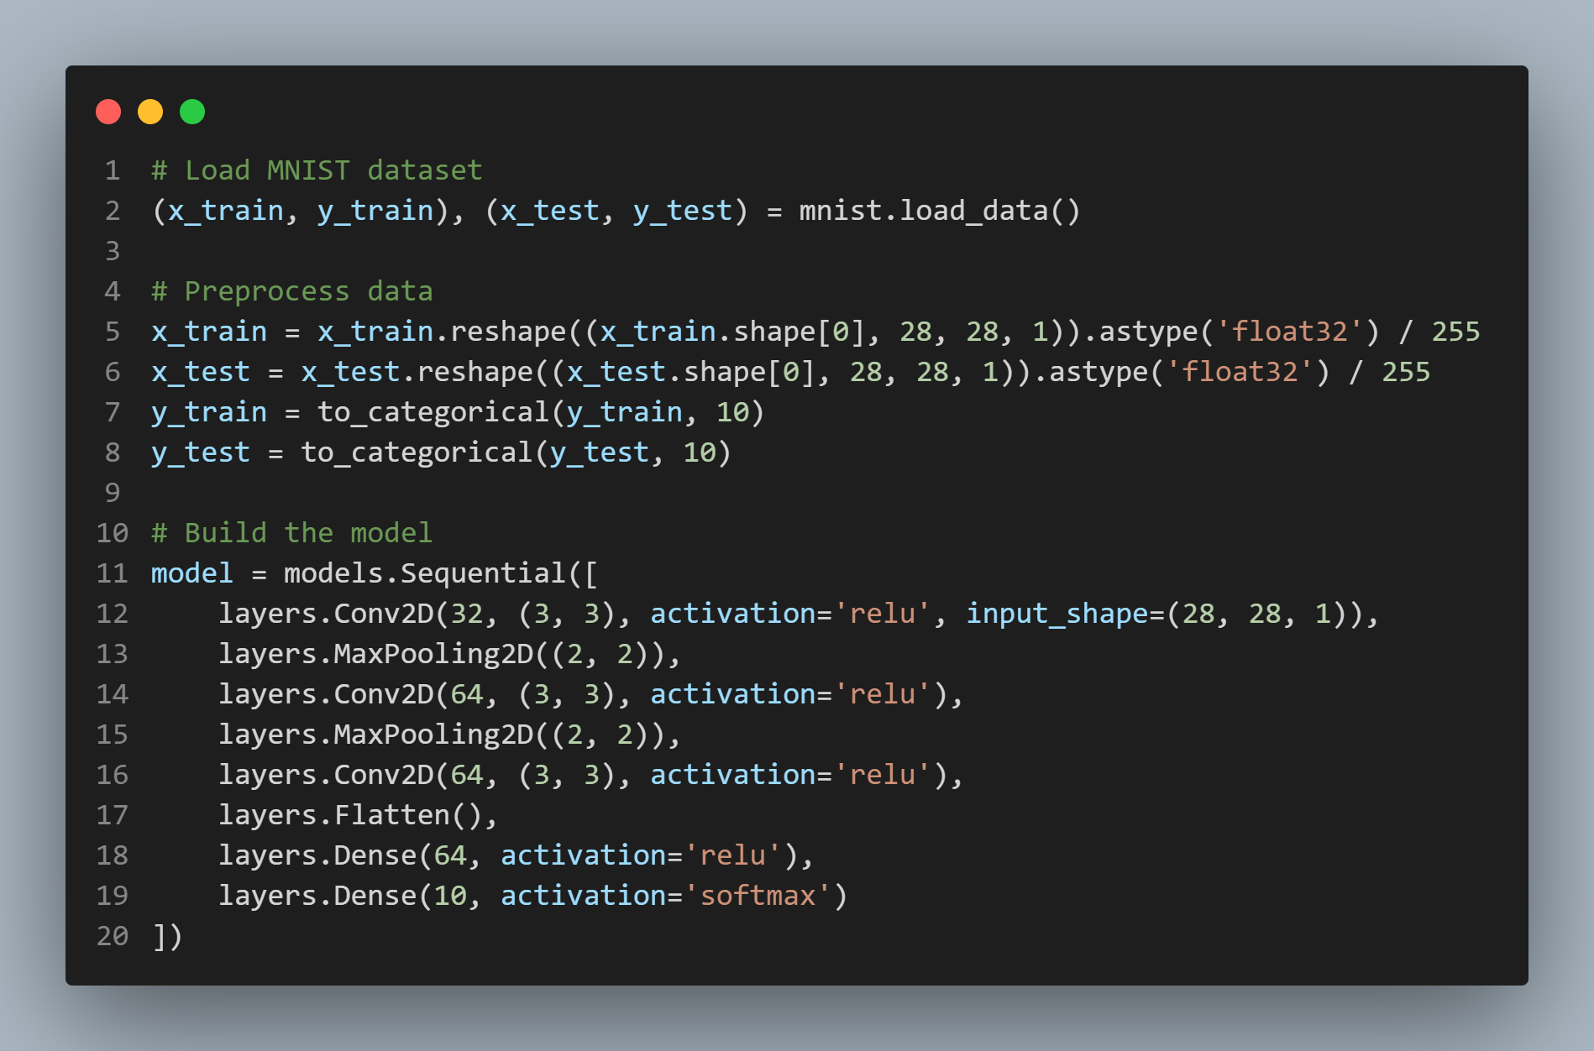

making a model.h5
Output

Slide 10
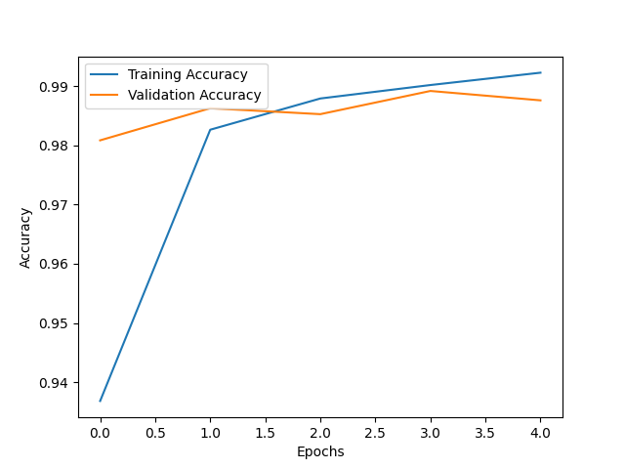
Blue Line
this to Indicates the training accuracy, which steadily increases as the model learns from the training data.
Orange Line:
Represents validation accuracy, which shows how well the model performs on unseen validation data during training.
Training Accuracy : The model achieves near-perfect accuracy (close to 99%)

Slide 11
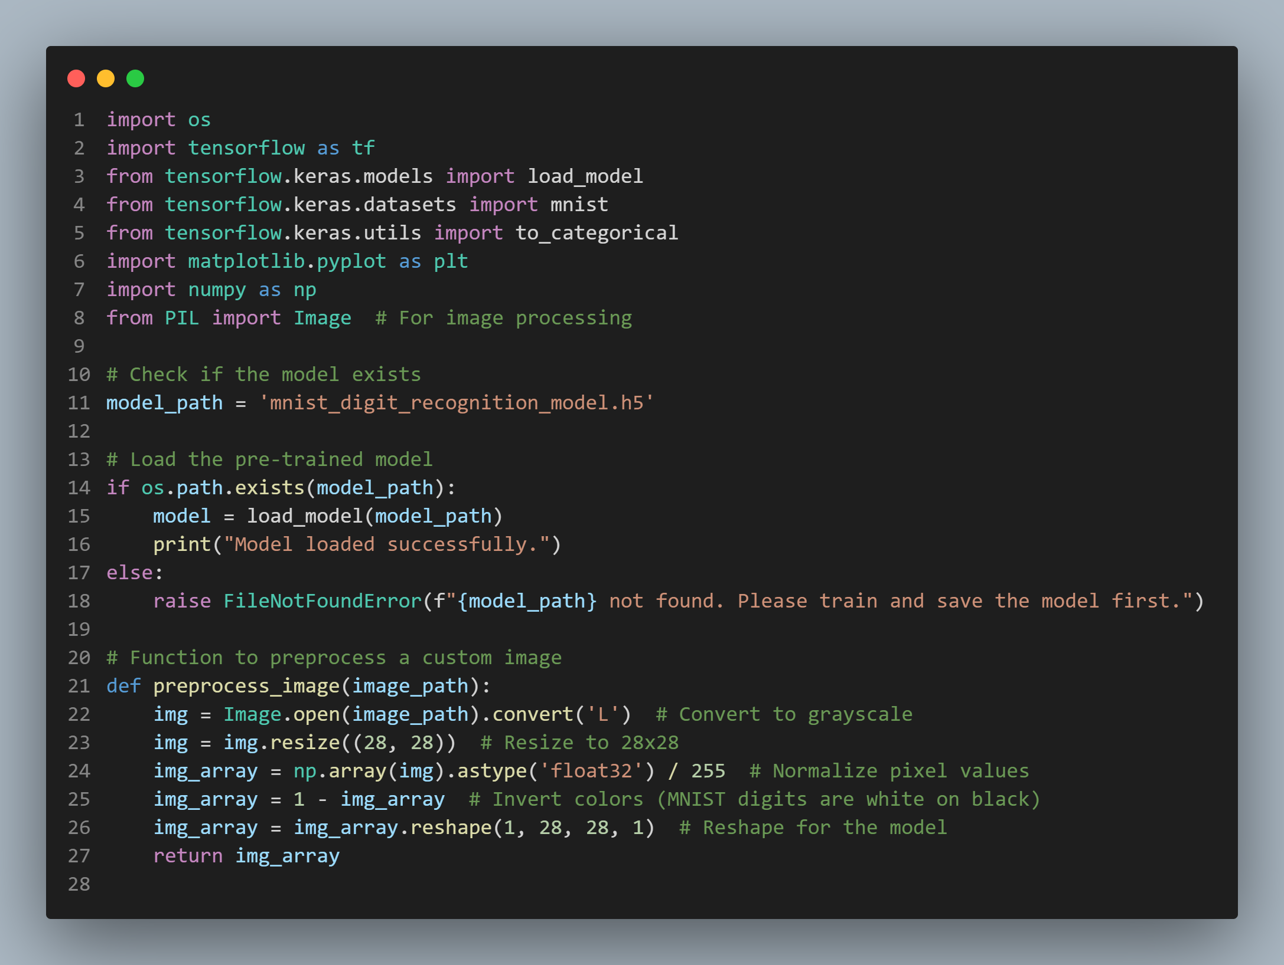
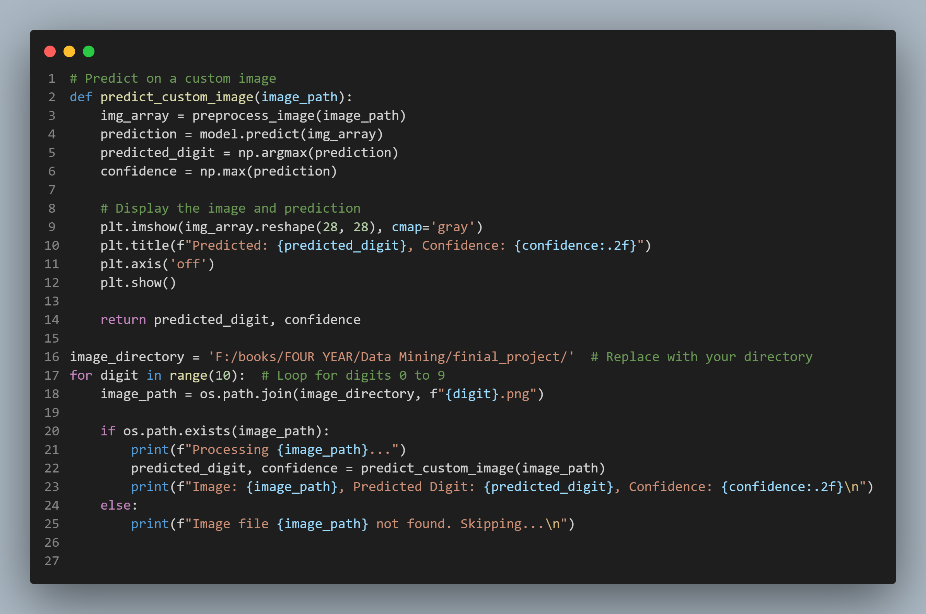
how to using this model

Slide 12
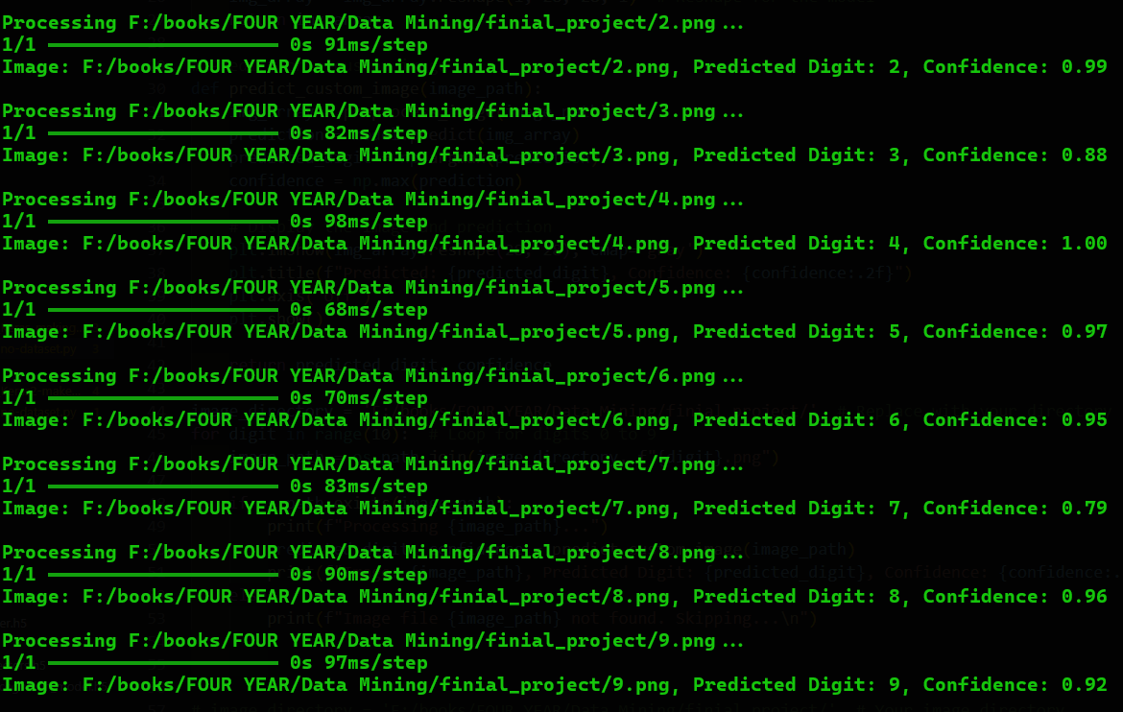
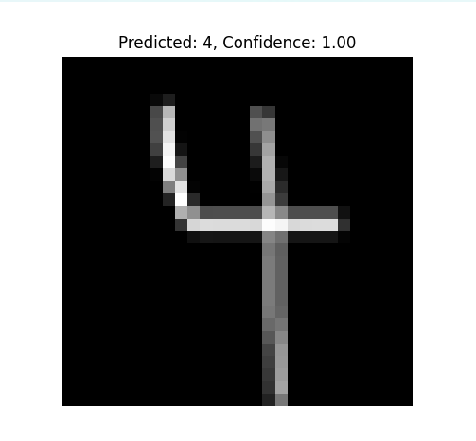
Results

Slide 13
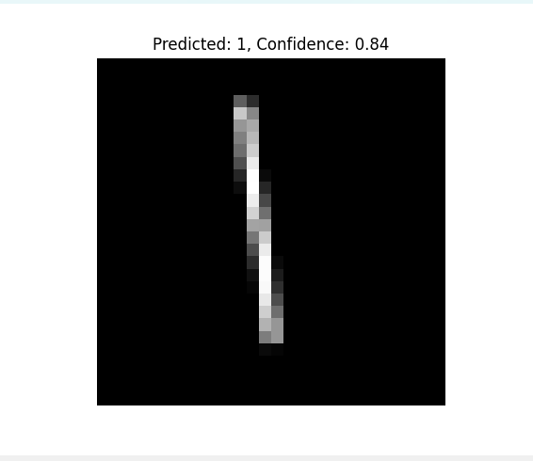
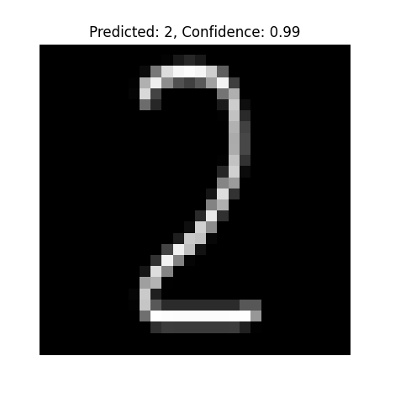
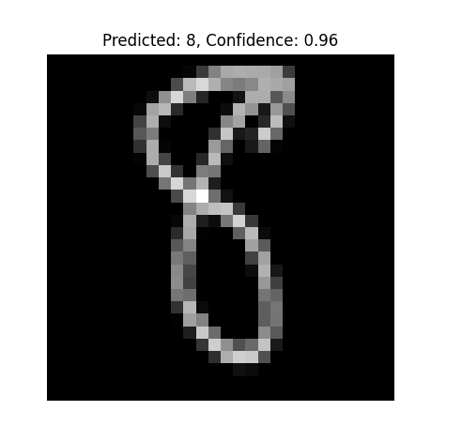
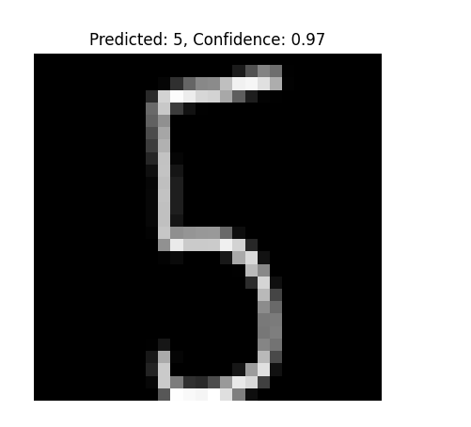
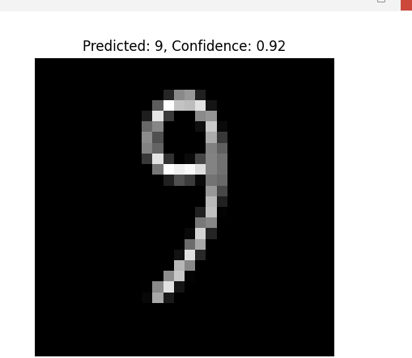

Slide 14


Challenges
PyTorch
There was a library called PyTorch, but after searching and checking carefully, I found that this library is the best solution, and even the fastest.
scikit-learn
While scikit-learn is a fantastic library for traditional machine learning, it is not optimized for deep learning tasks. It does not provide the flexibility and scalability needed for complex neural network architectures like Convolutional Neural Networks (CNNs), which are crucial for image recognition tasks.

Slide 15
After all the effort and fatigue, this model can be used to determine the categories of images, whether from 0 to 9.

Slide 16
References
https://en.wikipedia.org/wiki/Data_mining
https://www.kaggle.com/datasets/sagyamthapa/handwritten-math-symbols?select=dataset
https://www.techtarget.com/searchbusinessanalytics/definition/data-mining111t6
https://opencv.org/blog/pytorch-vs-tensorflow/
https://www.tensorflow.org/
https://scikit-learn.org/stable/
https://www.tensorflow.org/install
https://www.kaggle.com/datasets/sagyamthapa/handwritten-math-symbols
https://pytorch.org/tutorials/beginner/pytorch_with_examples.html
https://pypi.org/project/torch/

Slide 17
END
Thank you

